Slide 1
Michigan Biological Software JavaScript Tutorial
Fall 2017

Slide 2
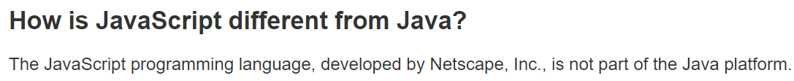
DISCLAIMER
JavaScript (JS) has absolutely no relationship with Java
https://www.java.com/en/download/faq/java_javascript.xml

Slide 3
Motivation for JS
Want our websites to be responsive
How do you send data to a server?
Re-render the page every time new information is sent

Slide 4
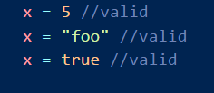
JS Overview
JS is loaded with the page; if you change a function you need to reload the page
JS is typeless, unlike C++ or Java
Check out https://www.w3schools.com/js/default.asp for more information

Slide 5
JS Overview: “Variable” types
Variables
Arrays – Similar concept to lists
JSON Objects – have properties with specific names

Slide 6
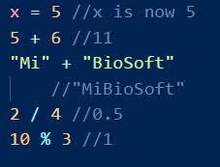
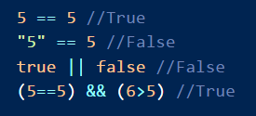
JS Overview: Operators
Assignment operator (=) assigns values to variables
Mathematical operators (+ - * / %) return numbers*
Comparison operators (== < > <= >=) evaluate to true or false
Logical operators (! && ||) evaluate to true or false

Slide 7
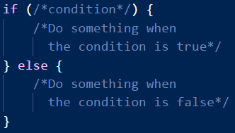
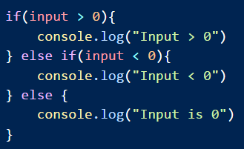
JS Overview: if-else statements
Executes block of code when a condition is met
Optional else block executes when condition is not met
Can string multiple if-else blocks together to get logic to work

Slide 8
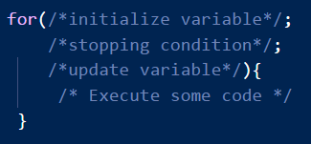
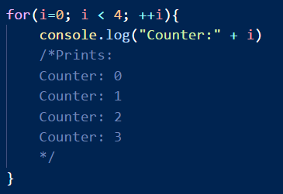
JS Overview: for loops
Execute some code repetitively
Execute some code for each element in an array
Should be used when you know how many times you want code to be run

Slide 9

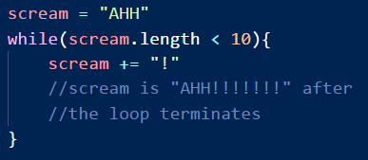
JS Overview: while loops
Execute code until some condition is not met
Useful when unsure when you’d need to stop
Make SURE condition can be false

Slide 10
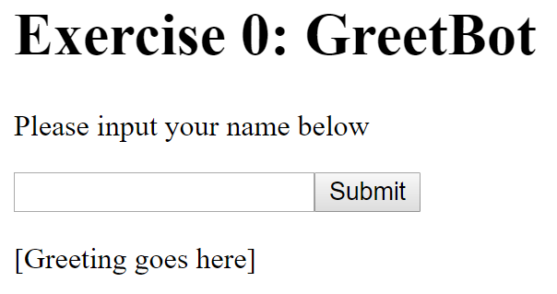
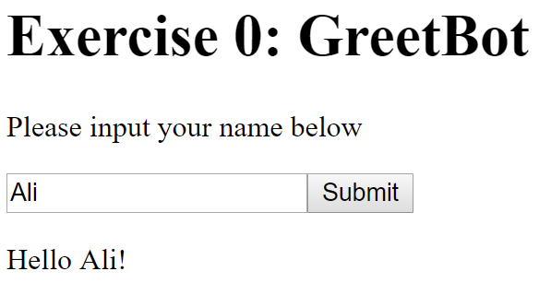
Exercise 0 Overview
Enter name and click submit
Text “Hello <name>!” appears

Slide 11
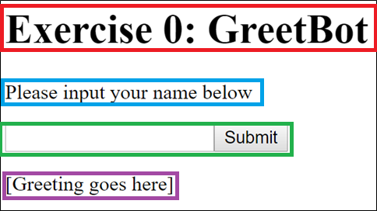
Exercise 0 Code
<h1>Exercise 0: GreetBot</h1>
<p>Please input your name below</p>
<input id="ex0_in" type="text" />
<button onclick="ex0();">Submit</button><br />
<p><span id="ex0_out">[Greeting goes here]</span></p>
<script>
function ex0() {
name = document.getElementById("ex0_in").value;
if (name.trim() == "") {
alert("Please enter a valid name!");
return
}
document.getElementById("ex0_out").innerHTML = "Hello " + name + "!";
}
</script>

Slide 12
Exercise 0 Concepts: Button onclick
<button onclick="ex0();">Submit</button>
“onclick” specifies some JS code to run when the button is clicked
In this case, execute JS function ex0

Slide 13
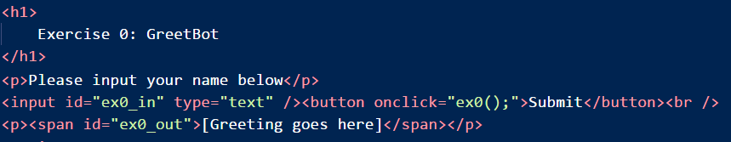
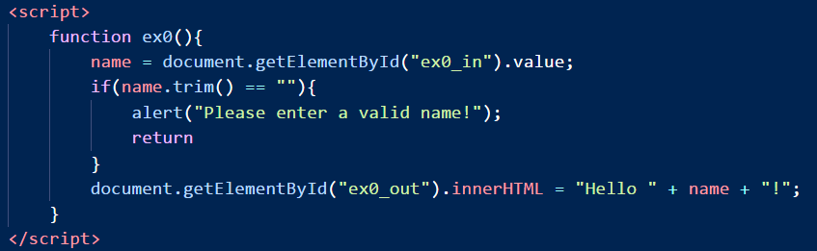
Exercise 0 Concepts: Script Tag
Lets us define JS code in the body of the document
Define function ex0()
Extract contents of “ex0_in”, store them in name
Validate the data
If data validation fails, abort
Set html content of ex0_out to be “Hello <name>!”

Slide 14
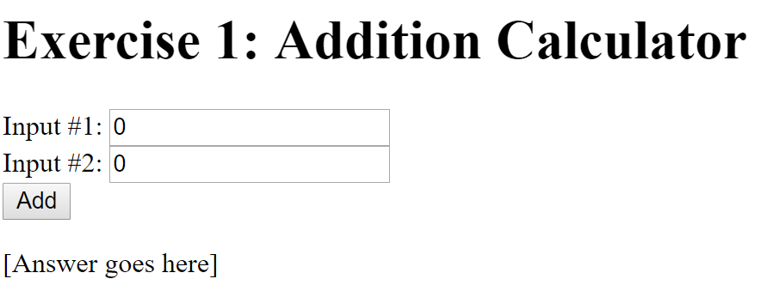
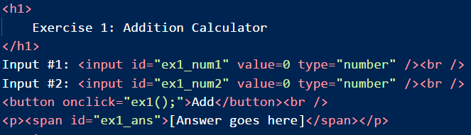
Exercise 1: Addition Calculator
Modify contents of <script> tag
Give numbers as input
Replace “[Answer goes here]” with their sum
Hint: You’ll need to extract the contents of the <input> elements

Slide 15
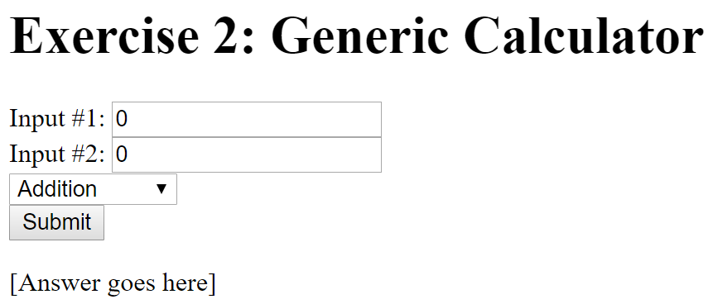
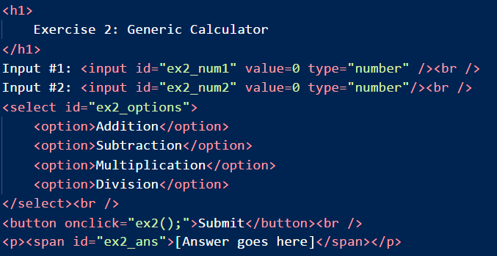
Exercise 2: Generic Calculator
Give numbers as input
Select one of Addition, Subtraction, Multiplication, Division for the operation
Clicking Submit replaces “[Answer goes here]” with the answer
Hint: How can you get the contents of the select box?

Slide 16
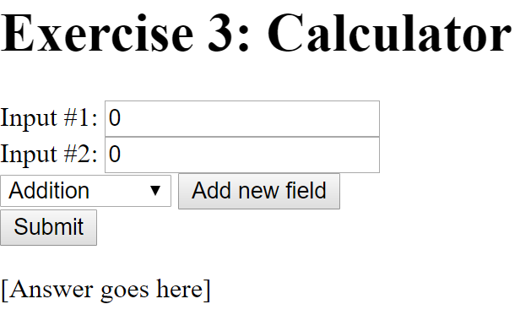
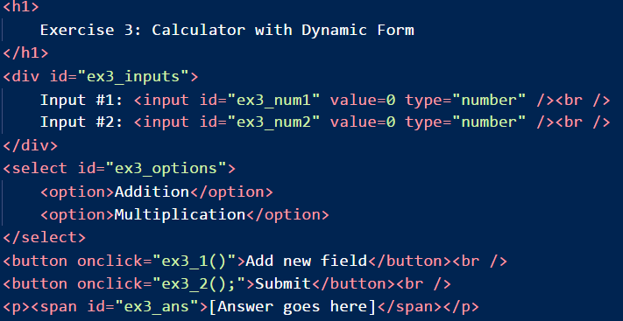
Exercise 3: Calculator with Dynamic Form
Give numbers as input
Can add new input field by clicking “Add new field”
Select one of Addition, or Multiplication for the operation
Clicking Submit replaces “[Answer goes here]” with the answer

